Slide 1



RED
Research. Education. Development.

Slide 2
Navigating Financial Conflicts of Interest in Research:
A Guide for Research Administrators
Tammy Kuhn Martin
Assistant Dean for Research Admin
College of Engineering
Stephanie LeRoy
COI Compliance Manager
Office of the Vice Chancellor for Research
Sam Leinweber
COI Compliance Manager
Office of the Vice Chancellor for Research

Slide 3
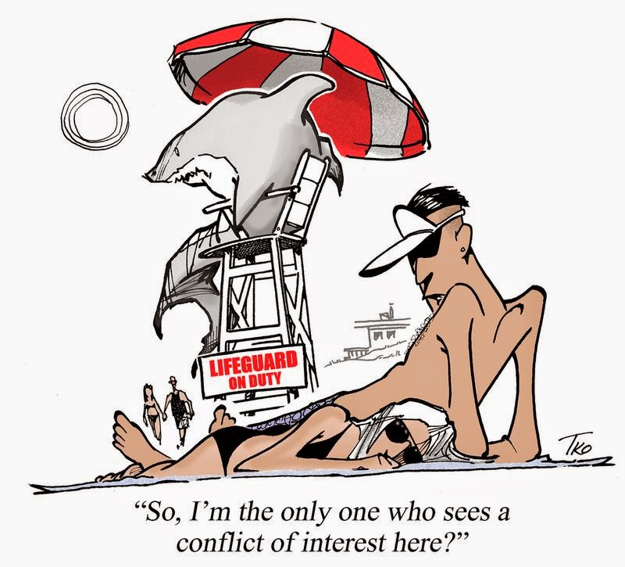

Today’s Goals
Understand the 4 types of conflicts
Understand how the FCOI regulations promote transparency and protect research integrity
Know your responsibilities to the institution and
the government
Identify reportable outside relationships and
where to report them.

Slide 4
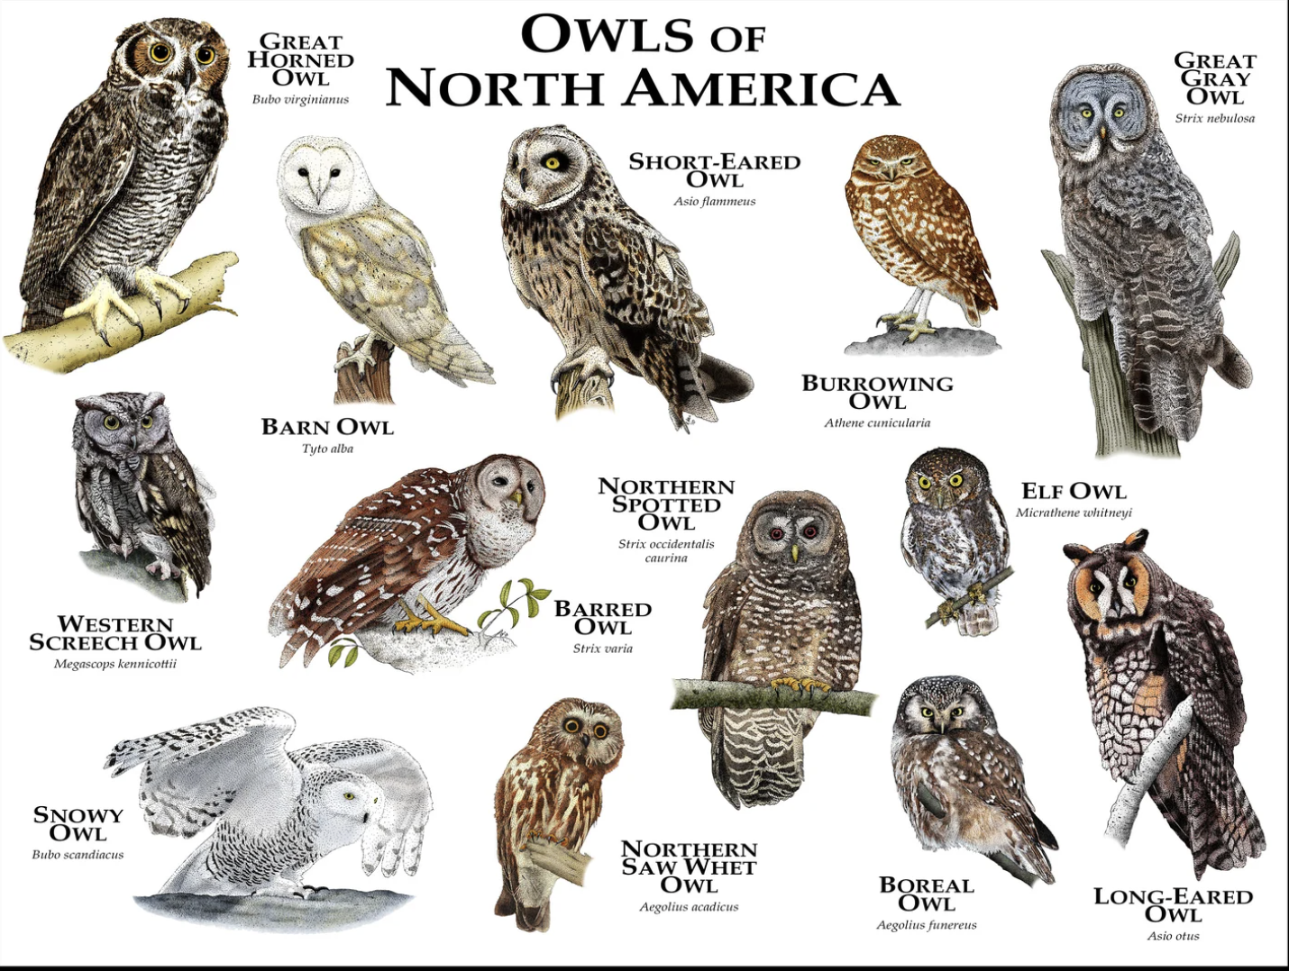
The many types of COI
  COI (Conflict of Interest): Research bias due to financial interests
  ICOI (Institutional Conflict of Interest): Conflicts stemming from institutional ownership or leadership interests
  OCI (Organizational Conflict of Interest): Unfair advantage in federal contracts
  COC (Conflict of Commitment): Conflicts related to an individual's institutional responsibilities

Slide 5
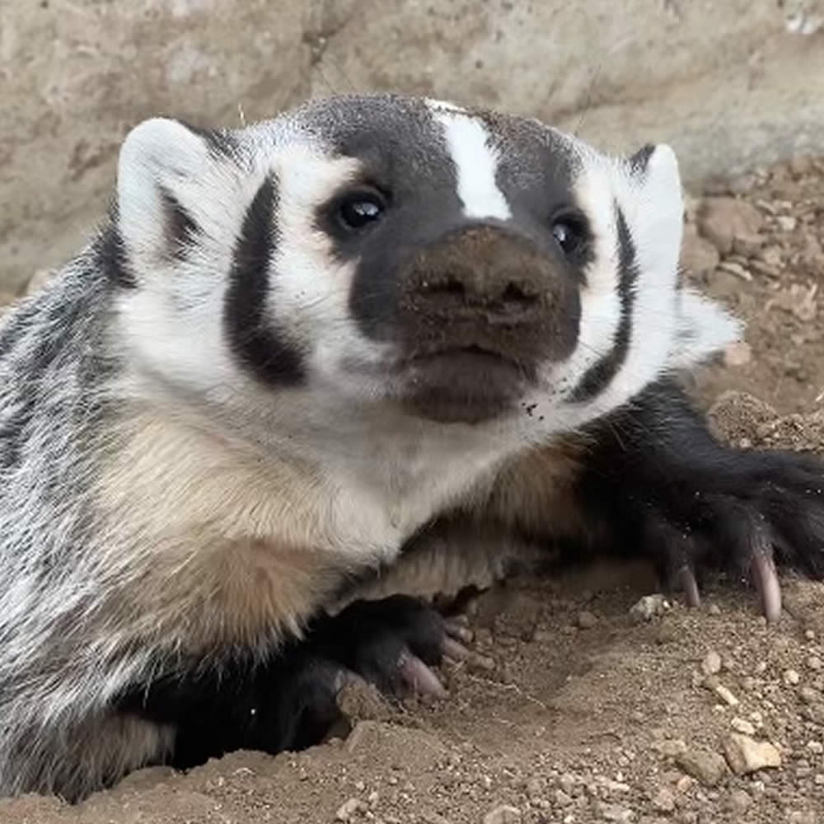

COIs: Perception v. Reality
Represent a state of affairs, not behavior,
Frequently involve perceptions, and
Are judged by others, not by those directly involved

Slide 6
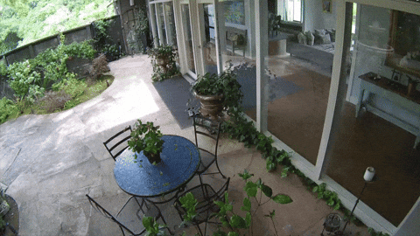
Transparency
Maintain public trust and continued extensive support of research through tax dollars
Maintain trust of patients in recruitment as human subjects
Embedded in research policy to reward researchers who use transparent practices
Ensure research is not biased in its design, conduct or reporting, and to ensure the protection of human subjects

Slide 7
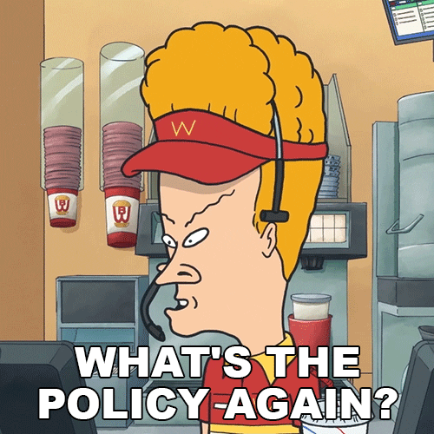
Disclosure Policies
• UWS8
• Wis. Stat. §946.13
• UW COI Policy
• 42 CFR Part 50 subpart F & 45 CFR Part 94
Notes:
There are a few policies that govern the COIs and disclosure requirements at UW that Sam mentioned.
Cannot use UW position or resources in a manner conflicting with UW's interests to gain anything of substantial private benefit of UW employee, their family, or an organization with which they are associated - this is the policy that requires outside activities reporting for non-researchers.
Self dealing statute - prohibits contracts where a public employee negotiates or enters into a contract in which s/he has a private interest. If the contract is between a research company and UW, requires evaluation of the conflict and that a specific management plan is issued and followed (if conflict is manageable)
To ensure that research is not biased in its design, conduct or reporting, and to ensure especially the protection of human subjects

Slide 8
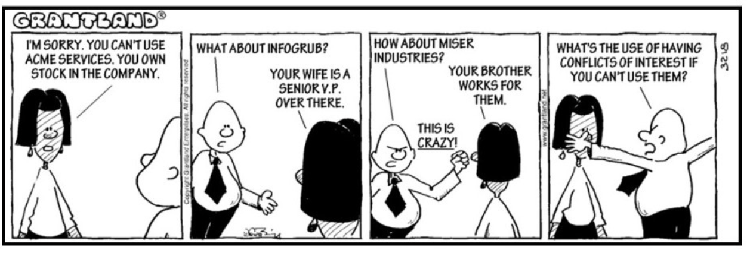

Slide 9
Who Needs to report
All UW–Madison faculty, regardless of appointment level
All UW–Madison academic staff and limited appointees with total appointments equaling 50% or greater
All PIs, Co-Is, and senior/key personnel on current federal grants
All individuals listed as study team members on human subjects protocols approved by UW-Madison's IRBs
All individuals with a current active management plan
All individuals when requested by their Dean’s office or the COI Office

Slide 10

What to Report?
All outside activities or compensation related to your institutional responsibilities, including your spouse's or immediate family's outside activities
Compensation
Ownership
Leadership
Academic appointments
Foreign research support
Travel*
Notes:
Early disclosure is key – many solutions go beyond the requirements of the management plans – Even the ones listed in the management plan take time to get through
Things like: Facilities Use agreements, finding a non-conflicted advisor for a student

Slide 11
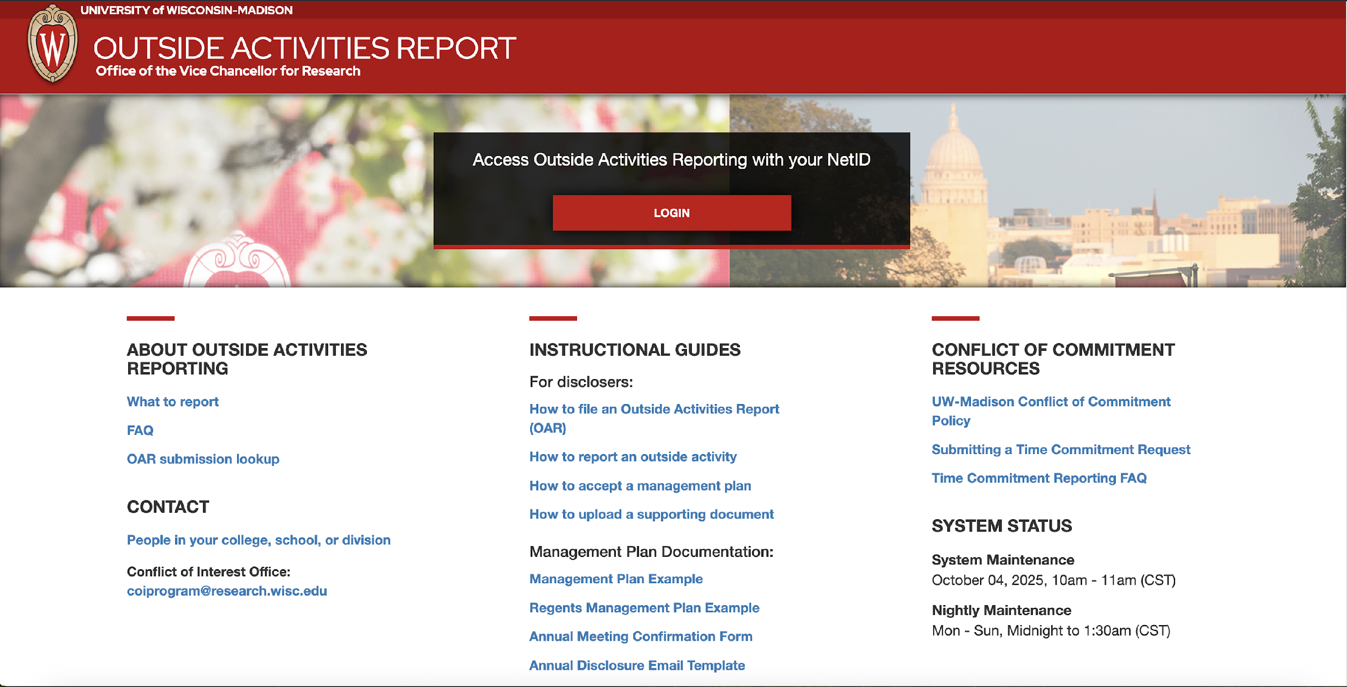
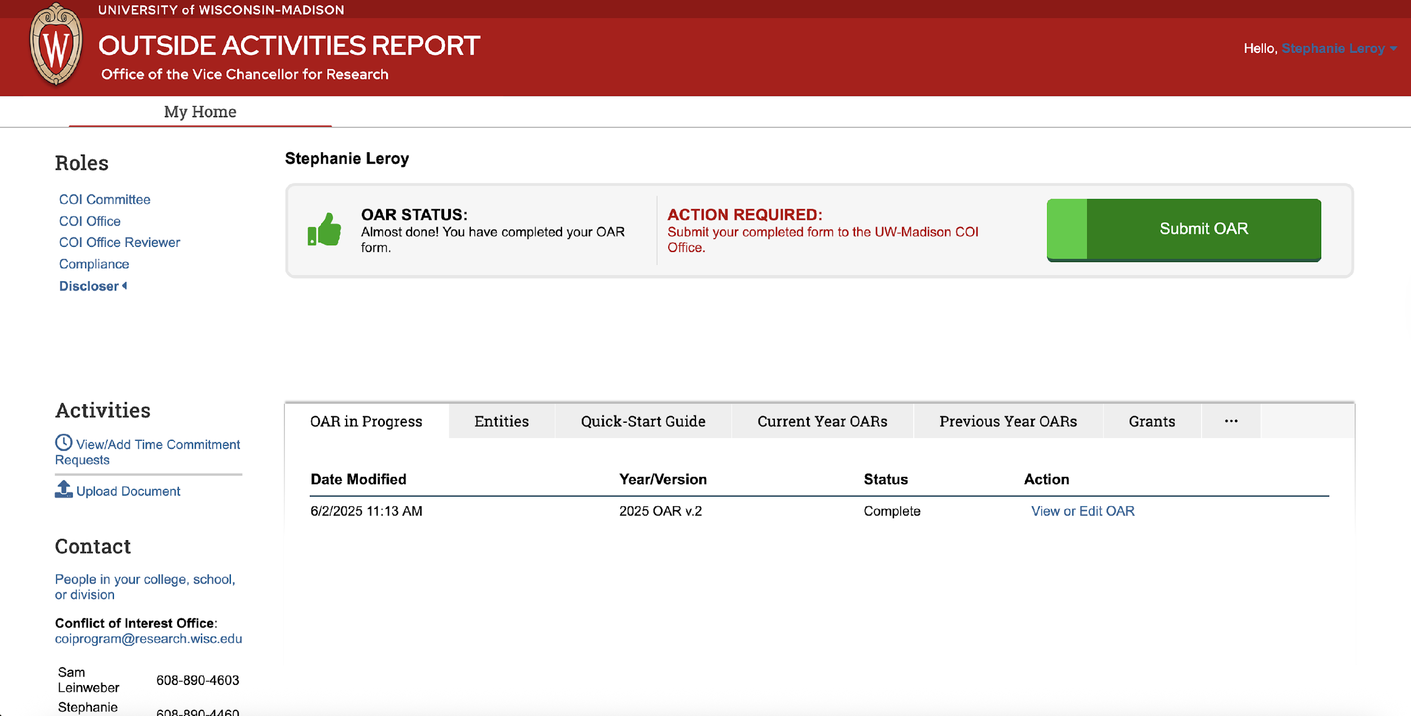
Where to Report: oar.wisc.edu

Slide 12
When to Report
Annual Report
Faculty, staff at ≥50% appointment
Relevant changes
Within 30 days of the change

Slide 13
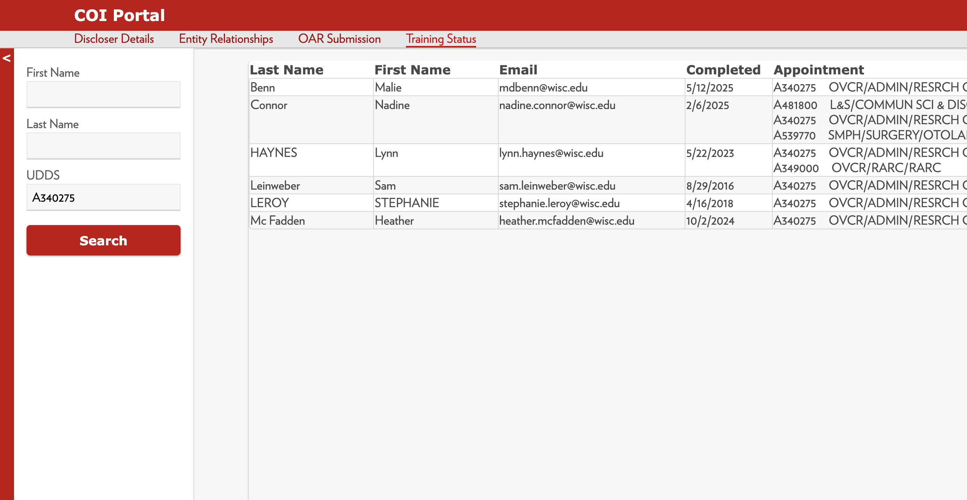
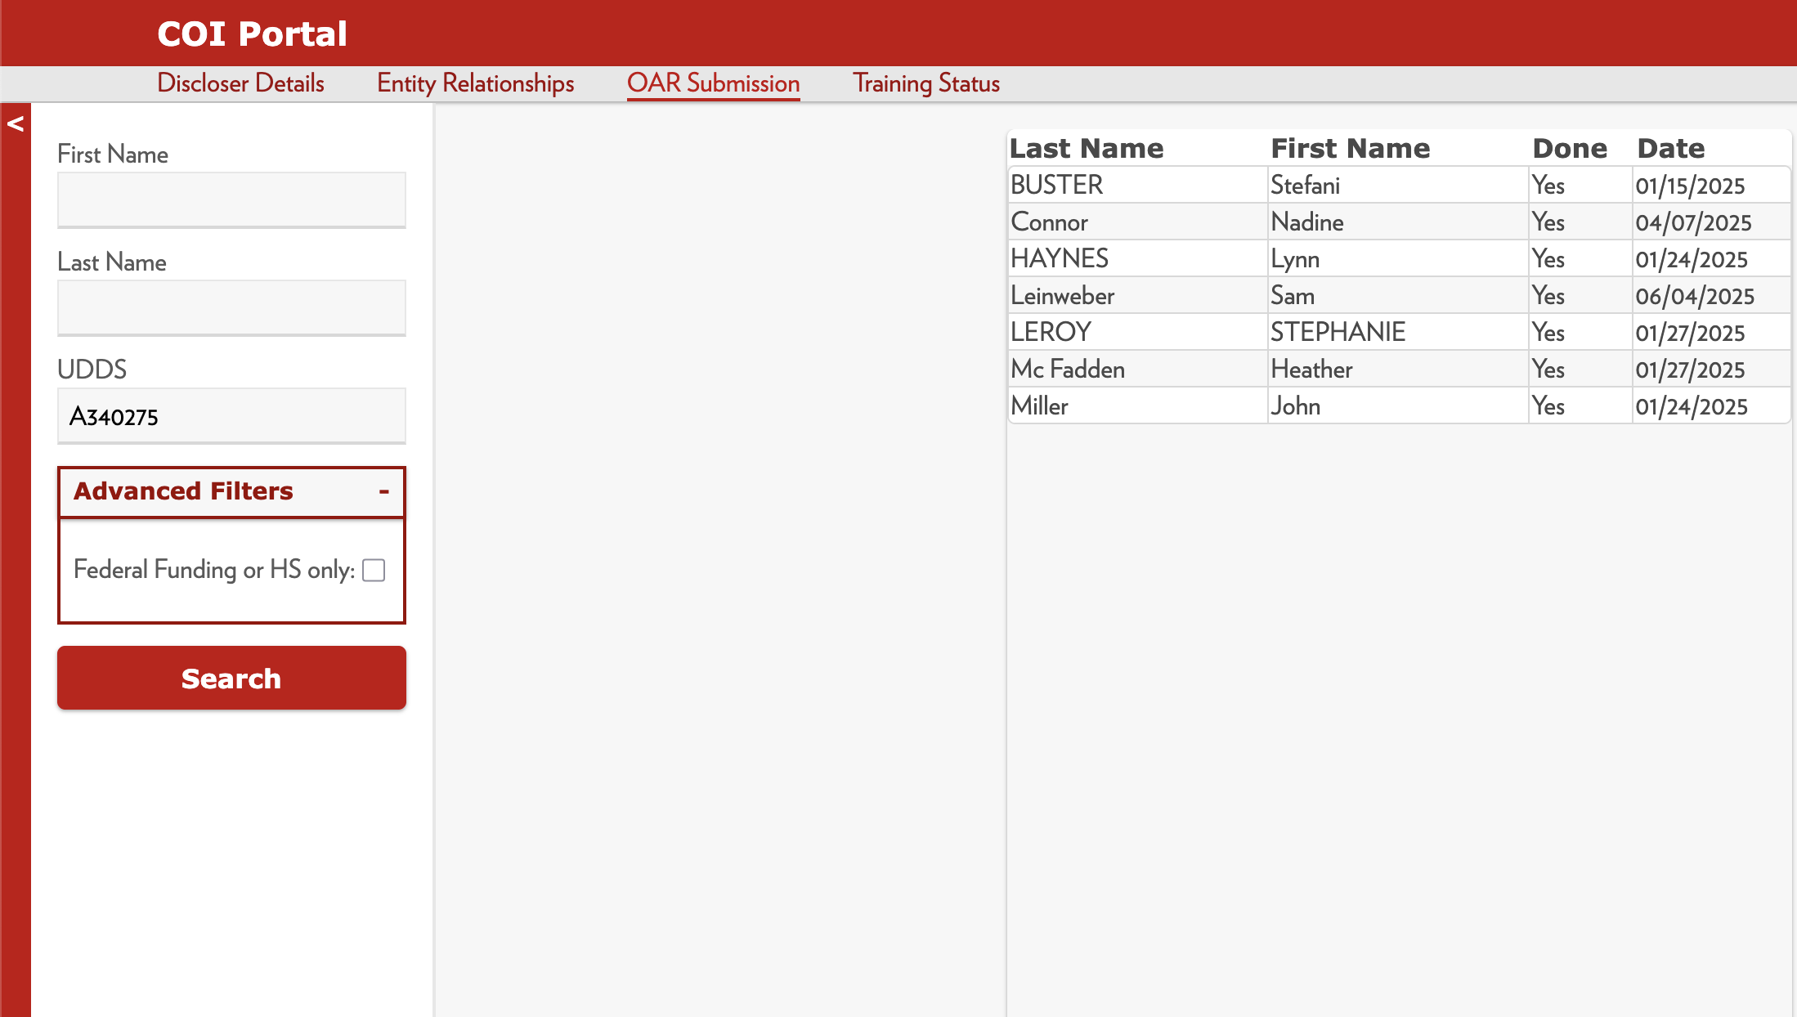
COI Compliance Lookup Tool
Discloser Details
Entity Relationships
OAR Submission
Training Status

Slide 14
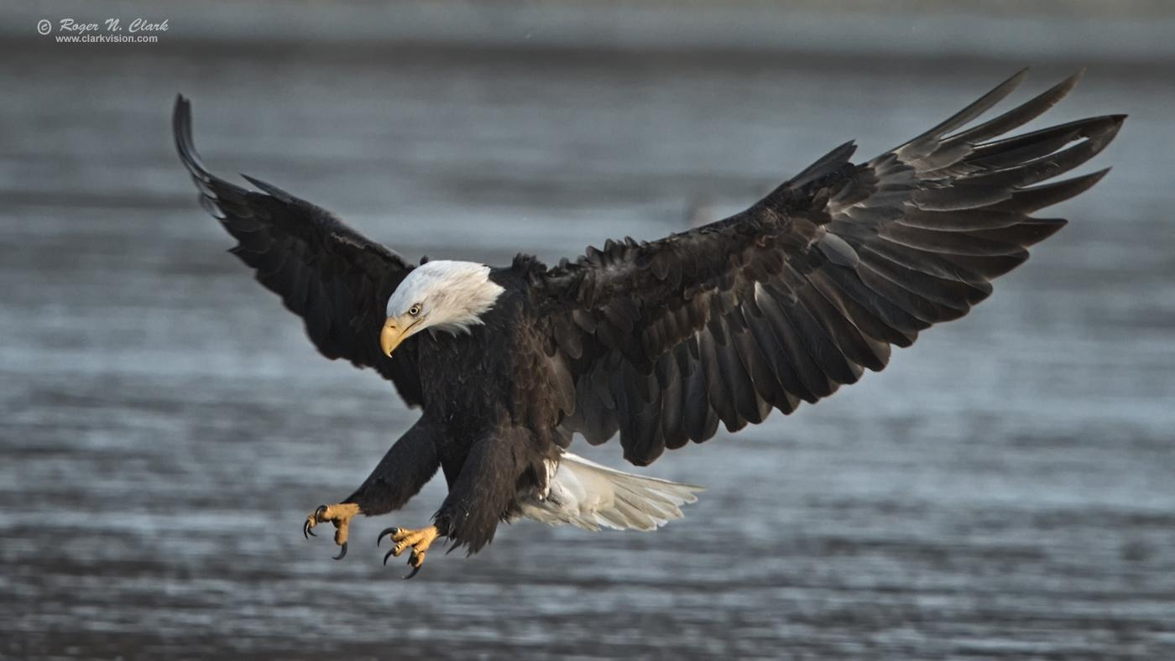
Noncompliance
Can lead to termination and/or loss of privilege to serve as an investigator on federally funded research projects or human subjects research protocols
Funding may be suspended or not set up at RSP until disclosure and training requirements are met
Loss of trust from the public
Financial penalties from funding agencies
Federal prosecution
Internal retrospective review
Notes:
Deliberate misrepresentation of information

Slide 15
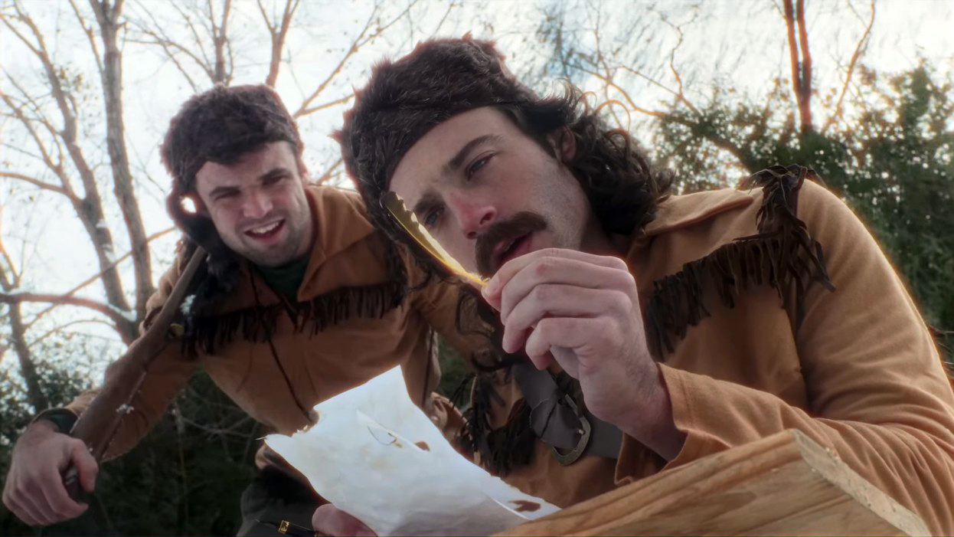
Thank you!
Any Questions?
Contact us:
Tammy Kuhn-Martin: tamara.kuhnmartin@wisc.edu
Stephanie LeRoy: stephanie.leroy@wisc.edu
Sam Leinweber: sam.Leinweber@wisc.edu
https://www.youtube.com/watch?v=zl-wAqplQAo

Slide 16
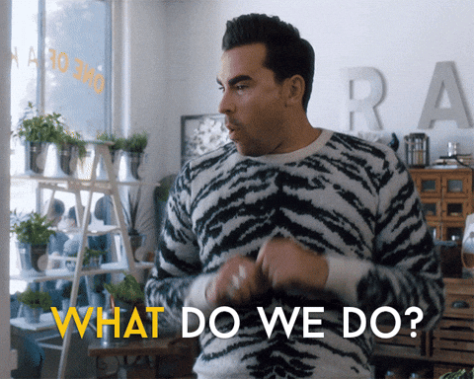
Scenario 1
Professor Badger has a 20% faculty appointment at UW-Madison and consults for a pharmaceutical company on an ongoing basis for over $100,000 a year. The same pharmaceutical company would like to provide, for no cost, a specialized drug manufactured by the pharmaceutical company for a clinical trial at UW, where Professor Badger would be PI on the protocol.
What should Professor Badger do first?
Should this be permissible?
Is there a way to mitigate the conflict?
What if another manufacturer provided the drug?

Slide 17
Scenario 2
Professor Zee has a full-time Faculty appointment with SOHE. In addition to her Faculty position, Prof. Zee is also a director at a non-profit that consults with a local public health organization that serves non-English speakers in the community.
The non-profit has received a joint federal grant with the local public health organization to conduct a human subjects study at UW-Madison and in the local area. UW-Madison will be the IRB of record.
Professor Zee is the lead writer of the IRB protocol as the community partner expert and non-native English speaker and is listed as key personnel on the grant. She is not PI on the protocol or the grant.
She is the leading community-researcher on this project and one of the contact people in the informed consent forms.

Slide 18
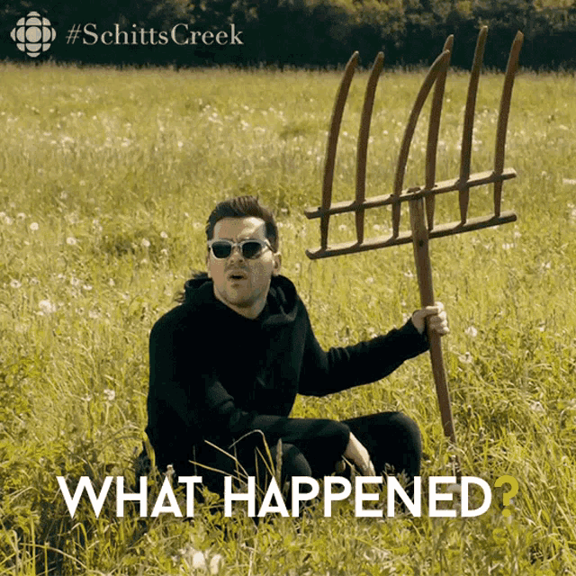
Scenario 2 continued
What is the FCOI concern here?
Are there any other concerns?
What type of a conflict-of-interest management plan is advised or needed?
Why might the university encourage this type of research anyway?
In addition, other employees at the local public health organization will serve as external research collaborators, but they are not part of UW in any way. Would a COI management plan apply to them too?

Slide 19
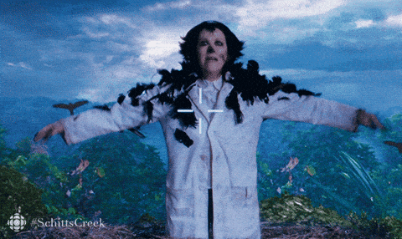
Scenario 3
UW-Madison, Professor Bee has invented new widgets that he was able to patent outside of WARF. Professor Bee created a private company, ABeeC, LLC, to hold and license the patent, of which he is 50% owner and on the board of directors. He subsequently has received royalty payments and other income from his company ABeeC, LLC. Professor Bee would like to continue to use the now patented widgets in his research at UW-Madison.
What types of conflicts might arise?
What if WARF held the patent and licensing rights?
What, if any, type of management plan would Professor Bee need?
Would it matter what type of research is being conducted with the widgets?

